Slide 1
Understanding Statistics in SQL Server
Deepthi Goguri

Slide 2



About me
Database administrator with 7 years of experience.
Microsoft certified trainer (MCT)
Microsoft certified solution expert (MCSE).
Masters in Computer Technology.
Blogger for dbanuggets.com
@dbanuggets
dbanuggets@hotmail.com

Slide 3
Overview
What are Statistics?
How to view Statistics?
What happens when they are wrong?
How to update statistics?

Slide 4
Statistics: What is it all about?
Information about the distribution of data.
Query optimizer uses statistics to determine how many rows are returned (Cardinality estimates)
Accurate estimates help optimizer generate good plans.

Slide 5
Why should we care?
Slow query response times due to inefficient plans
Excessive resource utilization (CPU, Memory, IO)
Spills to disk
Reduced throughput and concurrency

Slide 6
How query optimizer uses statistics?
Structures to be used (CI, NCI)?
Seek or Scan?
Look ups Needed?
Hash join,
Nested loop, Merge join?
Serial or Parellel?
Batch or row execution mode?

Slide 7
What could go wrong?
Query Optimization
Query
Transformation
Cardinality
Estimation
Costing
Plan Cache
Query Execution
Query
Plan Cache
Memory Grant
Query Execution

Slide 8





Fixed memory: Memory grant connections
Memory Grant connections
Resource Governor
Fixed memory
Query
We allocate this memory at startup of query execution based on our plan and cardinality estimates
Query Execution
Execution plan
Memory Grants
Spills to the disk

Slide 9



Fixed memory: Memory grant connections
Memory Grants
Fixed memory
Memory
Leaks
No access to other operations
Memory error
MSG 701
Resource semaphore waits
Memory pressure
Plans get evicted from plan cache

Slide 10
Memory grant feedback
2017- Supports Batch mode for columnstore indexes
2019-Row mode for hashes and sorts
For compatibility level 150
Feedback is lost when the cached plan is discarded from cache, memory pressure, changes are not captured in query store, lost when there is failover.
First execution
Adjusting
Stable
Disabled

Slide 11
Database level options for statistics

Slide 12
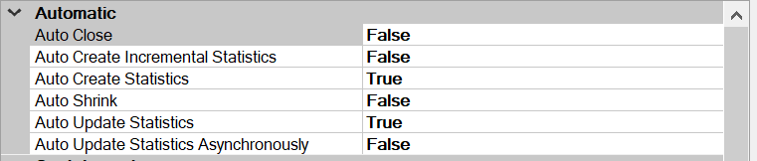
Database level options for statistics
Auto Create Statistics
Enabled by Default
Auto Update Statistics
Enabled by Default
Auto Update Statistics Asynchronously
Disabled by Default
Auto Create Incremental Statistics
For partitioning

Slide 13
How statistics get created?

Slide 14
Many ways statistics gets created
Automatically
Every index, filtered index, indexed view

Slide 15
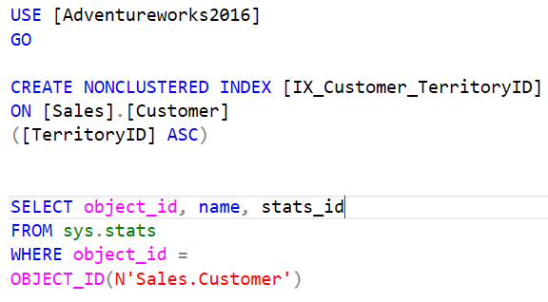
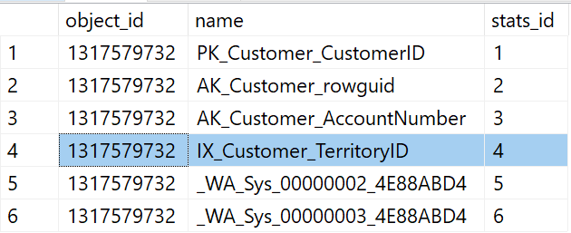
Examples for statistics creation

Slide 16
Many ways statistics gets created
Automatically
Every index, filtered index, indexed view
Single columns

Slide 17
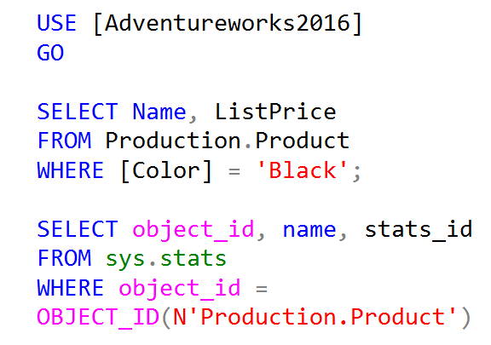
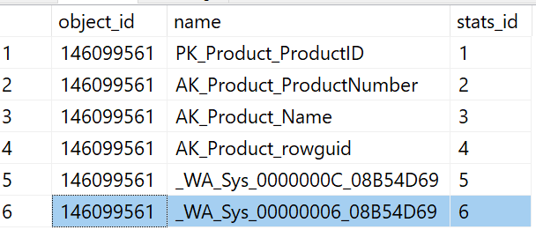
Examples for automatically created statistics

Slide 18
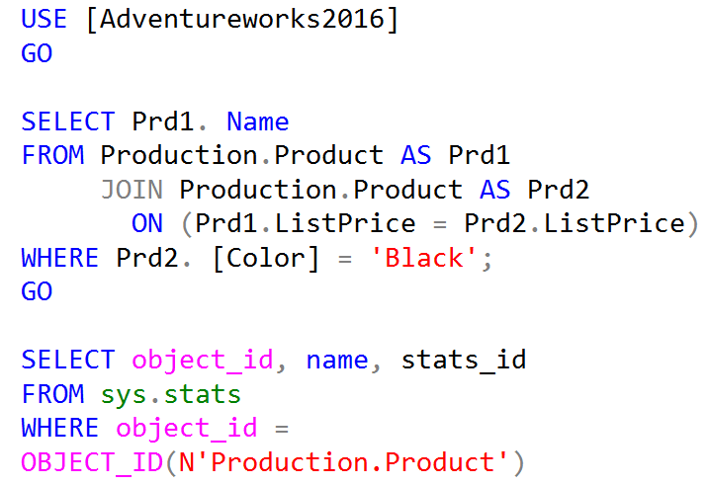
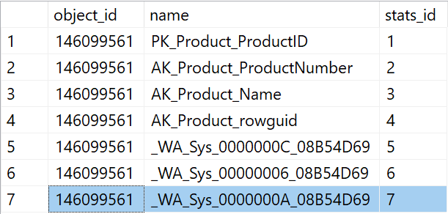
Examples for automatically created statistics

Slide 19
Many ways statistics gets created
Automatically
Every index, filtered index, indexed view
Single columns
Manually
Multiple columns
Single columns
Filtered values in a column

Slide 20
Viewing statistics

Slide 21
Viewing Statistics
Sys.stats- To get the list of all statistics for a table.
DBCC SHOW_STATISTICS
Header
Density Vector
Histogram
Sys.dm_db_stats_properties - Header Info
Sys.dm_db_stats_histogram - Histogram

Slide 22

<DEMO>

Slide 23
Updating the statistics

Slide 24
Old vs New threshold
AUTO_UPDATE_STATISTICS =ON
Old threshold
20% + 500 rows changed
New threshold
SQRT(1000*Number of rows)

Slide 25
New Threshold
SQL Server 2016 and Higher
Enabled by Default
Compatibility >130
Older versions of SQL Server
TF 2371
Up to SQL Server 2008 R2 SP1

Slide 26
Updating statistics: AUTO_UPDATE_STATS
SQL Server Version | AUTO_UPDATE_STATS | Data Change | Plan Invalidation
Before SQL Server 2012 | OFF | Regardless | NO
Before SQL Server 2012 | ON | Regardless | YES
SQL Server 2012 and Above | ON | If no Data change | NO

Slide 27
Updating statistics: Auto update statistics asynchronously
Disabled by Default
SQL Server 2019
Wait type: WAIT_ON_SYNC_STATISTICS_REFRESH
When enabled: Updates happen Asynchronously

Slide 28
Updating statistics: Maintenance
Maintenance plans
Options
NORECOMPUTE
PERSIST_SAMPLE_PERCENT (SQL 2016 SP1 CU4, SQL 2017 CU1)

Slide 29
What default sample should be used?

Slide 30
What default sample should be used?
Use the default sample: SQL Server can choose anywhere below 100%
Usually default sample less than 10% for large tables
Use 100% for columns with very skewed distribution

Slide 31
Common reasons for incorrect estimates

Slide 32
Common reasons for incorrect estimates
Missing statistics
Statistics not updated properly
Inadequate sample rate
Uneven distribution of data
Table variables
Local variables
Linked servers

Slide 33
Points to remember

Slide 34
Points to remember
If data not in statistics
2012 or less
returns 1 row
2014 or greater
All density * # of rows
When Indexes are rebuild, Index statistics are updated with full scan.
SQL Server requires NOEXPAND hint to produce a query plan that accesses an indexed view. When NOEXPAND is specified, automatic stats are created on index view exactly as happens with the ordinary tables.
Manually update stats
UPDATE STATISTICS
sp_updatestats

Slide 35
Points to remember
What can invalidate the query plan?
Changing the schema of the table or view that’s being referenced in the query
Altering the stored procedure
Altering an index that’s used in the plan
Dropping an index that’s used in the plan
Updating the statistic that’s used in the plan
Using sp_recompile for an object (like stored procedures)
Using WITH RECOMPILE

Slide 36
Overview
What are Statistics?
How to view Statistics?
What happens when they are wrong?
How to update statistics?

Slide 37
References
https://docs.microsoft.com/en-us/archive/blogs/srgolla/sql-server-statistics-explained
https://eightkb.online/detail.html?session_id=196663
https://www.sqlskills.com/blogs/jonathan/enlarging-the-adventureworks-sample-databases/

Slide 38


